Slide 1
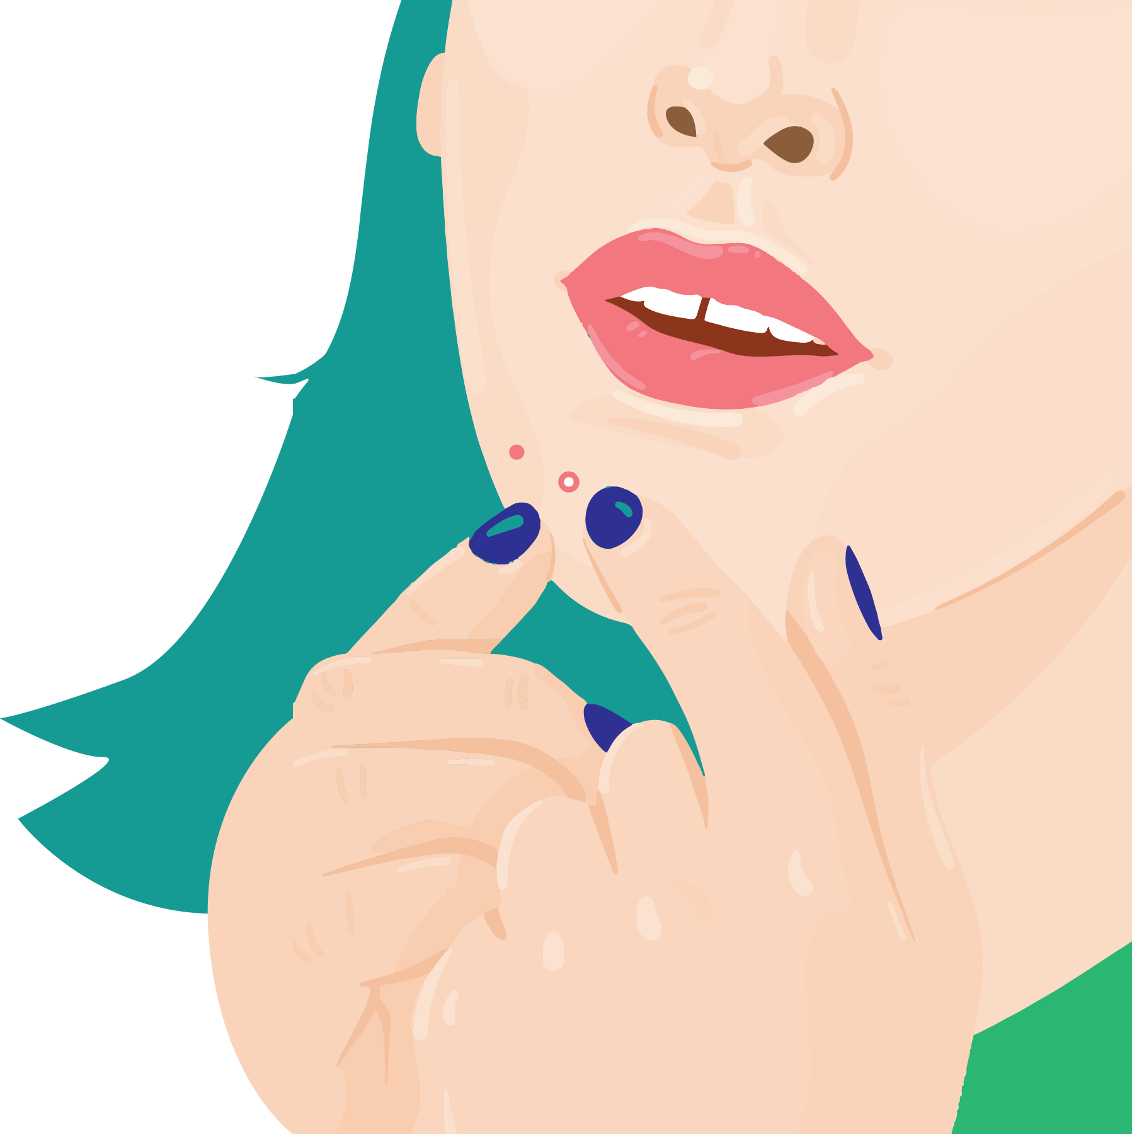
Acne Aid Plaster
For pimple protection
Sachira Karunasena, Pulasthi Ekanayake
Team Among Us (University of Moratuwa)

Slide 2
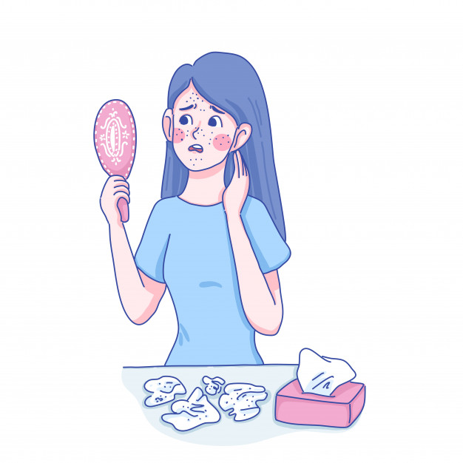
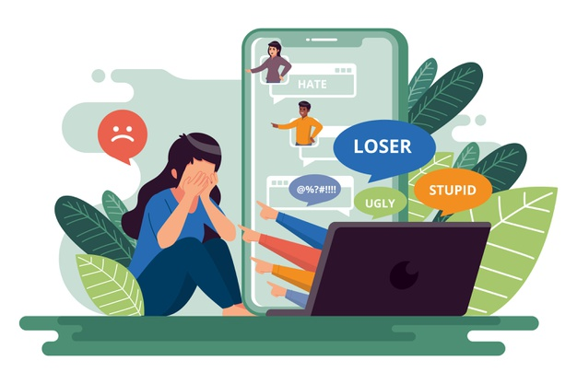
The Issue
Social Stigma
Physical and Mental scarring

Slide 3
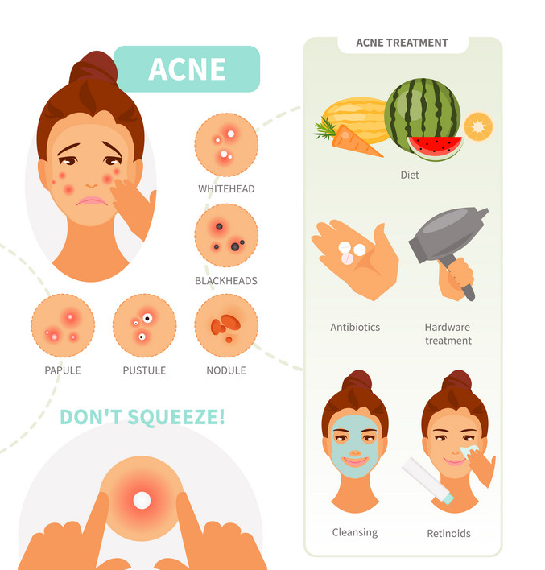
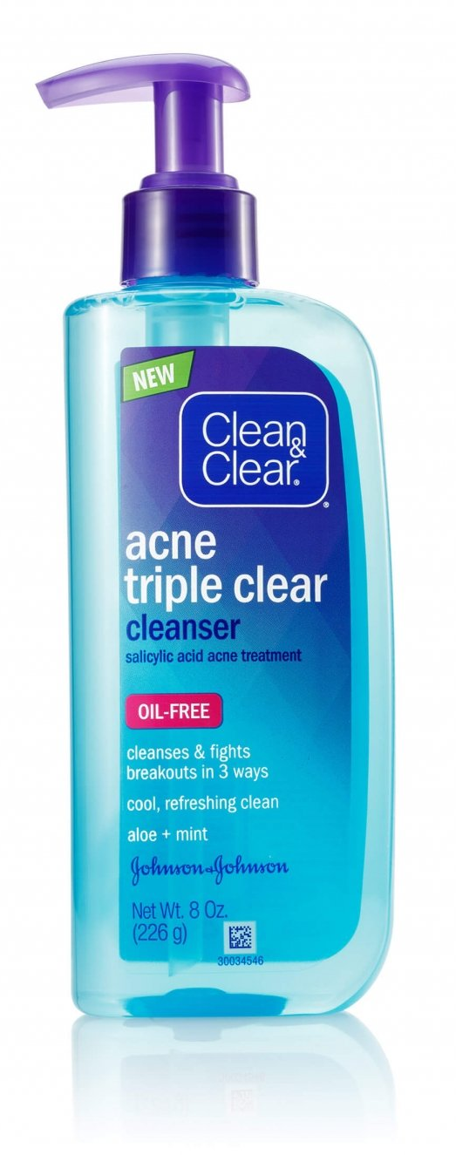
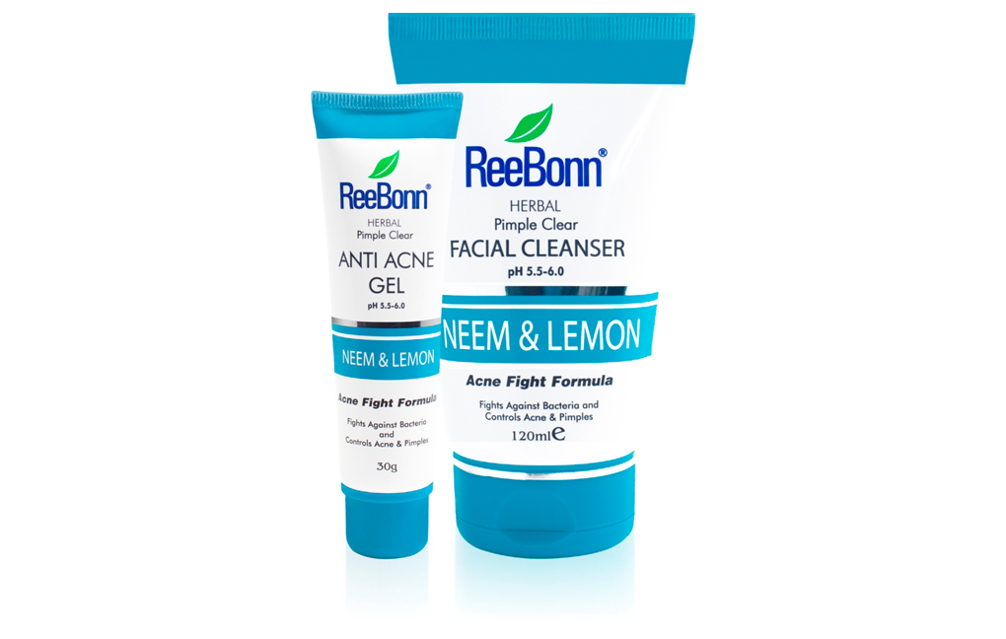
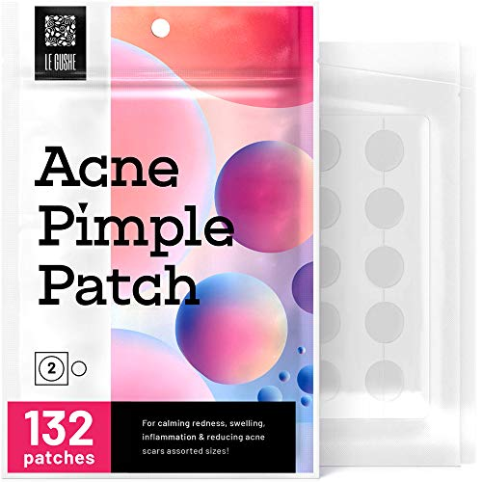
Consumer Landscape
Needs a quick solution
Gap in Sri Lankan market

Slide 4

Idea
Medicated Pimple patch
Protection & Treatment

Slide 5
Research
https://www.freepik.com/free-vector/cyber-bullying-concept_9005921.htm#page=1&query=bully&position=2

